Slide 1

Innovation cluster Modernization and Transformation options
Suresh Babu, SAP
Month 00, 2022
Partner logo

Slide 2
Extension Tasks for Presentation Tier
ID | Pattern | Modernization options (High level)
1 | Implicit Enhancements | 1. In-App Extensibility patterns
2 | CMOD | 1. Kernel BADI, 2. In-App extension 3. Side-by-side extension based on business use case
3 | ALV Reports(SAP GUI) | 1. Fiori Embedded analytics 2. SAC Analytics (Modernization)
4 | Custom Module pool transactions | 1. Fiori Transactional Applications 2. Side-by-side Fiori app based on use case
5 | SAP Script Forms | 1. Adobe output forms based on OData services
6 | BAPI | 1. S/4HANA Cloud compatibility with OData for synchronous or SOAP for Asynchronous (Integration scenario based on business needs)
7 | SM30 Data Maintenance | 1. Fiori and OData service (Simple scenarios can be automated to created Fiori Apps)
8 | Workflow | 1. BTP Even mesh, Workflow in BTP
9 | Table Modification(New fields) | 1. Append Includes, In-App Extension with Custom Fields and Logic

Slide 3
Patterns

Slide 4
BAPI Scenario

Slide 5

Custom tables/SM30

Slide 6

SM30 Table maintenance/Custom data
Modernization options
Reusable service in BTP(Steampunk)
Create data model and entity in SAP BTP
Generate and expose OData service using RAP framework
Create Fiori UI for data maintenance
Integrate SAP S/4HANA Cloud and SAP S/4HANA applications with OData service in BTP
Custom table/data
Customer maintains data using SAP GUI
Referenced in
User exits
BADI/Implicit Enhancements
Standard and Custom applications
Types of data
Customizing data
Custom rules
Application data
Developer Extensibility (Embedded Steampunk)
Applicable for both S/4HANA Cloud, S/4HANA on-Premise
Applicable for S/4HANA on-Premise and S/4HANA Cloud
Applications consume Public API(CDS view or oData service) service directly
Suitable for existing custom table, no need to change application code
In-App Extensibility(Custom Business Objects)
Recreate with new entity, table and business objects
Low-code,No-code to generate service and Fiori UI
Data protection and admin data automatically included
Suitable for new custom tables
Need for modernization
Customers’ use SAP GUI based SM30 transactions to maintain data in custom tables. SAP GUI is not allowed in S/4HANA cloud or BTP Cloud environment. Moreover, making the applications cloud ready for deployments to any premise that safeguards current investments. Hence, there is a need to modernize these maintenance transactions using Fiori UI that can be deployed in Hybrid landscape.
Custom rules with Business Rules Management service in SAP BTP

Slide 7



Enterprise Architect
Persona: Clemens, Enterprise Architect, Globalcorp Inc.
Challenges: Table maintenance generator is used to maintain data in custom tables for applications usage. SAP GUI is not allowed in cloud. our customers. I would like to know how many such custom tables that uses SM30 for data maintenance and the applications they are used. This will help to decide whether to keep keep the data close to core or into BTP cloud and integrate into applications.
Storyflow: See how cluster helps …
Count of custom tables with SM30 based maintenance by usage
Usage in different applications
How many applications each table is used in
Is there a mass data upload
Any ALV reports generated from these tables
Analyze
Transformation/Modernization options
What options are possible with existing business process
Any KB articles, Blogs and How to Guides to help customers to easily follow
Automation:
Business configuration tables are developed with special mechanism to transport data to all clients
Business Configuration for SAP Cloud Platform ABAP Environment | SAP Blogs
Use ADT based wizard to generate SAP Fiori table maintenance dialogs
For new custom tables that require close integration with SAP core data, use Custom Business Objects using In-App extensibility
Improve
Notes:
Let’s start with Clemens. Clemens is the Line of Business Manager of Globalcorp Inc.. He needs to assess performance and identify areas for improvement for his line of business
In the following demo story, your customer will see how Clemens…
…identifies the opportunities of improvement for the finance department by analyzing relevant performance indicators
…compares his company's performance against industry benchmarks
…understands how finance users use the processes and identify potential for usage optimization, training or automation
…Gets recommendations, based on performance and usage optimization, segmented by type, such as S/4HANA capabilities, situation handling, Fiori, automation bots and machine learning

Slide 8
BAPI

Slide 9
Modernize custom application with BAPI
Transformation options
Extensibility options
Side by side extension:
Cloud applications can leverage S/4HANA Cloud SDK to call relevant APIs from Business API hub to manage or query business transactions
Steampunk in BTP: Direct RFC call with S/4HANA on-Premise
Side by side extension:
BAPI in custom applications
External SAP or non-SAP applications
Custom application processes data before calling BAPI
Applications read business data for reporting
Maintain Business transactions in SAP
Mass data upload
Single transaction maintenance
Fiori Applications in S/4HANA and S/4HANA Cloud
Fiori Applications could be potential replacement for existing custom applications that uses BAPIs.
In-App extensions allow custom fields, custom logic in Fiori applications for customization
Need
Transform existing custom applications that uses BAPIs to be cloud ready for hybrid deployment scenarios.
S/4HANA Integration Scenario
S/4HANA Cloud uses BAPIs and RFCs to integrate with existing on-Premise SAP solutions
Integration using Cloud platform Integration is also possible
Target Architecture [oData, Webservice]
oData service as direct API for CRUD operation
Webservice for message based communication for Business transactions

Slide 10
Enterprise Architect
Persona: Clemens, Enterprise Architect, Globalcorp Inc.
Challenges: Many custom applications used same BAPI for creating business transactions, consolidate and re-platform existing custom applications to be cloud ready as BAPI technology is not recommended in cloud applications.
Storyflow: See how cluster helps …
Identifies Custom programs that uses BAPIs
BAPI is used for read or CRUD operation
Is BAPI used for mass creation of business transactions
Any custom rules has been implemented
Additional custom fields involved during transaction creation
Mass creation using Excel data is automated using iRPA
Custom programs with minimal customization can be candidate for Fiori In-App extension
Cloud applications, Developer extensibility in S/4HANA and ABAP in BTP can leverage public APIs
Analyze
Improve
Notes:
Let’s start with Clemens. Clemens is the Line of Business Manager of Globalcorp Inc.. He needs to assess performance and identify areas for improvement for his line of business
In the following demo story, your customer will see how Clemens…
…identifies the opportunities of improvement for the finance department by analyzing relevant performance indicators
…compares his company's performance against industry benchmarks
…understands how finance users use the processes and identify potential for usage optimization, training or automation
…Gets recommendations, based on performance and usage optimization, segmented by type, such as S/4HANA capabilities, situation handling, Fiori, automation bots and machine learning

Slide 11
Customer BAPI details from cluster

Slide 12
BAPI Data model
Fiori App library
Business API Hub
BAPI Master

Slide 13
Insights from Cluster
Custom programs corresponding to BAPI
Identify the custom programs for each BAPI
Count of programs in which each BAPI is implemented
Whether the program is self contained
How many other cluster references?
Process
Is it used for Read operation?
After BAPI call there will not be BAPI_TRANSACTION_COMMIT
Is it used for CRUD operation
After BAPI call there will be BAPI_TRANSACTION_COMMIT
Is the custom program calls File upload function
Excel file upload could mean mass creation of transactions
Is the BAPI call is RFC or internal call?
Relevant to determine what type of modernization can be chosen
How many function modules and methods referenced from custom program? and their centrality measures
Mass creation of business objects
Custom tables
May be there are custom rules implemented
Customization data
Missing in cluster
Data provider with custom program view
Answers to process section
Whether custom table is used
Need to integrate API & BAPI Master

Slide 14
Account Document posting Interface – Pattern 1
Z2A Cluster: 10653

Slide 15
Account Document posting with BAPI - Pattern 2
Z2A Cluster: 10653

Slide 16
File upload – Pattern 3
Z2A Cluster: 10653

Slide 17
Transformation option
Z2A Cluster: 10653
Discovery center article

Slide 18
ALV Pattern– Pattern 4
Z2A Cluster: 10653

Slide 19
ALV Pattern– Pattern 4
Z2A Cluster: 10653

Slide 20
Posting Interface Document
Z2A Cluster 10694
Interface used in 34 Custom Programs
Used Generally in :
Mass creation of FI Documents from file such as
Manual journal entries
FI postings from external systems
Part of period end closing

Slide 21
Usecase for Excel Upload
Z2D
Excel File upload
Posting Interface in the report

Slide 22
Usecase for Excel Upload
Z2A Cluster: 10694
Cluster 10694 supports mass creation of transaction pattern with the following patterns
Excel Upload function
Posting interface Module

Slide 23
Transformation scenarios
Robotic process automation
The general accountant has to do repeated and manual journal entries uploading work daily .He/she hope to released from the low value work.
Integration scenario
Side-by-side use case
Cloud Platform Integration on BTP

Slide 24
Appends
Output Forms
SAP Script
Smart Forms, programs
Custom tables
Enhancements
Executable custom program
Cluster 365
File processing
SAP_GUI
Custom tables
ALV FM
Custom programs
BAPI
Account Posting
Custom tables
Integration
Text
Acct Posting Interface(FM)

Slide 25
Output Forms
SAP Script
Smart Forms, programs
Data
Custom fields
Appends
Cluster 1604
Data
Custom tables
SM30
Transactions
Technology
SAP_GUI
File upload
Executable custom program
BAPI
Account Posting
Custom tables
Integration
ALV FM
Custom programs
Acct Posting Interface(FM)
Custom tables
Text

Slide 26
Forms

Slide 27
Enterprise Architect
Persona: Clemens, Enterprise Architect, Globalcorp Inc.
Challenges: Identify custom SAP Script forms and Smart forms, identify customizations such as rules, custom data enrichments and propose transformation option with insights from cluster
Storyflow: See how cluster helps …
Identifies standard or custom programs that are linked to custom forms ??
Application area of programs and number of forms in thar area
How complex the code customization
How many custom callable routines the main print program refers to
Any rules implemented(Custom tables)
Any custom fields(identify Append structures)
Identify forms/programs based on usage information, complexity of code and form customization.
Adobe forms service in BTP for generating forms
Standard APIs with possibility of extension for customization
Easily customize forms
Analyze
Improve
Notes:
Let’s start with Clemens. Clemens is the Line of Business Manager of Globalcorp Inc.. He needs to assess performance and identify areas for improvement for his line of business
In the following demo story, your customer will see how Clemens…
…identifies the opportunities of improvement for the finance department by analyzing relevant performance indicators
…compares his company's performance against industry benchmarks
…understands how finance users use the processes and identify potential for usage optimization, training or automation
…Gets recommendations, based on performance and usage optimization, segmented by type, such as S/4HANA capabilities, situation handling, Fiori, automation bots and machine learning

Slide 28
Forms Transformation Scenarios
Adobe Forms Customization
In-App Extensibility
Custom fields can be added to the data source
Copy standard form template and customize the layout
Expose custom fields in the form
Custom logic
SAP S/4HANA standard output management is utilized
SAP Form Service by Adobe in BTP
Use in S/4HANA on-Premise and S/4HANA Cloud
Non SAP and Cloud applications can utilize this service
No local Adobe document service infrastructure
Click here for more information
Side-by-side extension
Build SAPUI5 application, Cloud applications or ABAP on BTP
Customize data and form with greater flexibility
Data from cloud storage
Data fetched from S/4HANA for business objects and customized
Use Adobe forms service REST API to create document
Form templates and data model
SAP delivers standard data model and form templates
Output Management in SAP S/4HANA
Configures form templates with data model
S/4HANA on-Premise no changes required
S/4HANA Cloud uses output control service
Output Management in SAP S/4HANA
S/4HANA on-Premise
Develop custom Adobe forms with standard Odata API
Configuration of NAST for output determination as before
Use Adobe forms service REST API to create document

Slide 29
Adobe Service
Cloud Application via REST API
SAP Forms service REST API calls the SAP Forms service from a cloud application
SAP Forms service configuration UI to customize rendering behavior
ABAP Application on SAP S/4HANA On Premise
SAP S/4HANA on-Premise application calls SAP Forms service
SAP cloud connector is used
ABAP Application on SAP BTP
SAP Forms service is called from an ABAP application running on BTP
Click here for more information

Slide 30
Custom Forms information

Slide 31
Insights from Cluster
Main print program
Identify the custom or standard program for custom
Smart form
SAP Script
Custom forms
Number of forms a print program is attached to
Table TNAPR is starting point for the configuration link
Determines what to consider during modernization
Custom tables
May be there are custom rules implemented
Customization data
Custom program includes, methods and functions
Extent of custom logic
Custom table includes
Potential custom fields

Slide 32
Configuration and objects in cluster
TNAPR is configuration table core on-Premise
Print programs are assigned to custom form
Standard or custom programs
Cluster story
Form objects are available with no edges
Custom programs does not have edge to form
Build Transformation story for Forms
Display only clusters that print program belongs to with edges(Most of code customization is in programs)
Includes
Custom tables accessed
Callable routines(FUNC, Methods etc)
Establish link to Form(Collector or Specific to this usecase)
Types of Forms

Slide 33
Extension Pattern
Custom Code Clustering Mockup from 07-07-2022

Slide 34
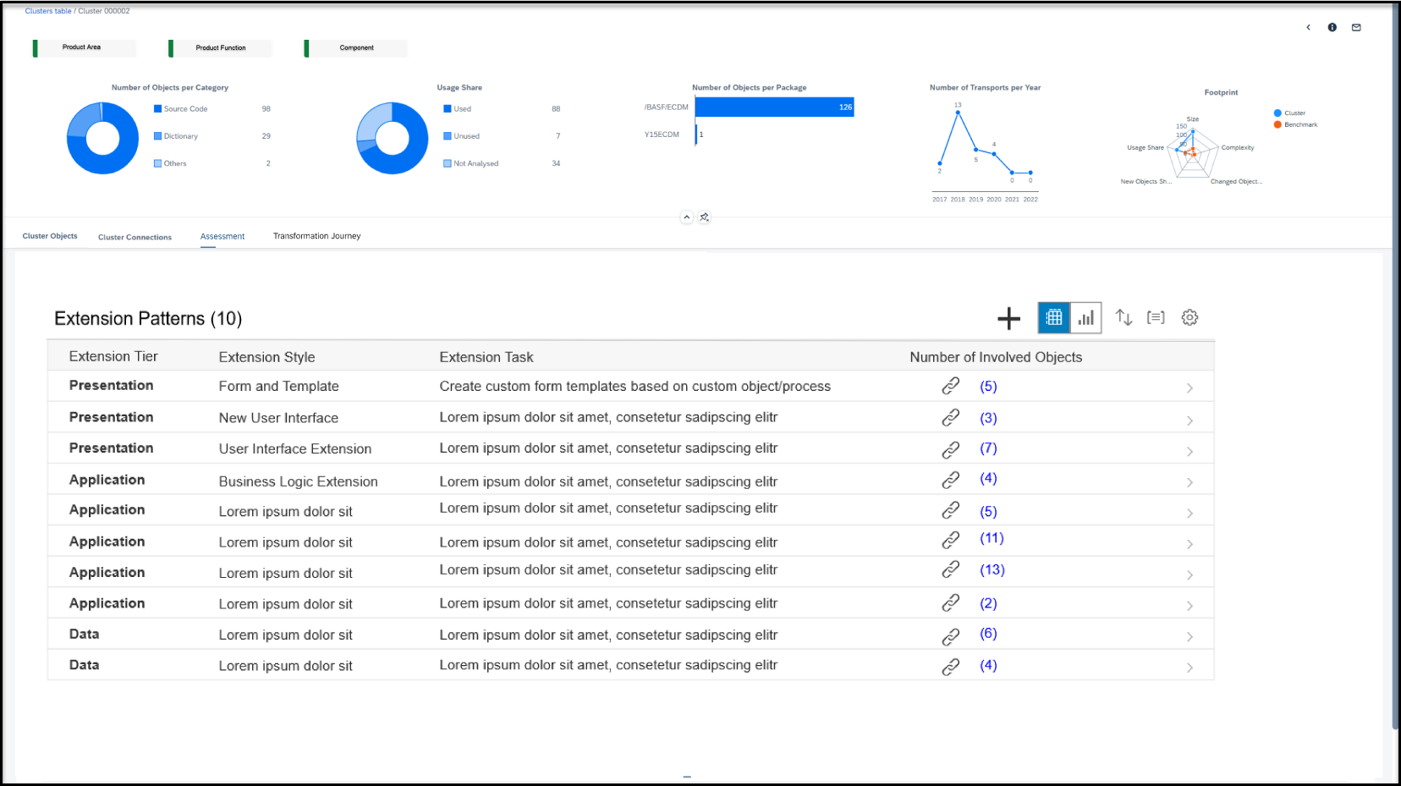
Mockup – Cluster Transformation Journey (1|3) Forms
New Tab “Assessment" to identify “Extension Patterns” in Cluster
Extension patterns are identified through referenced Objects in a Cluster.

Slide 35
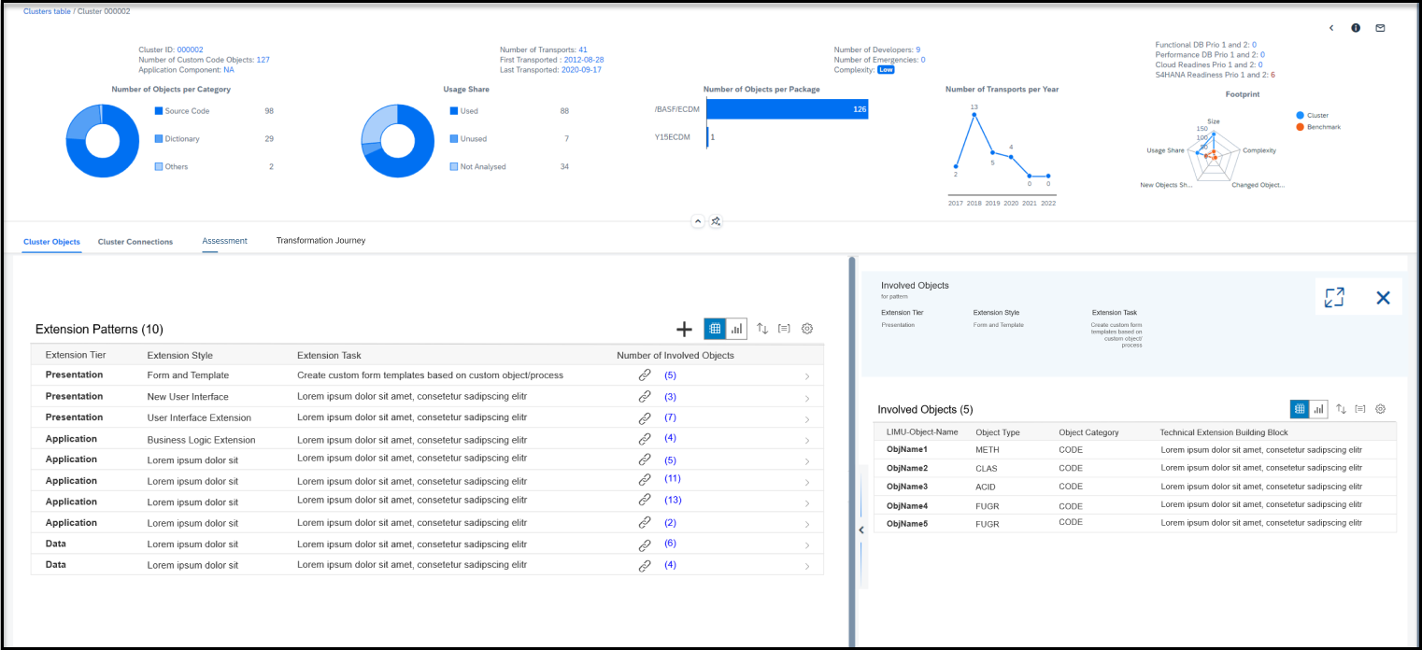
New Tab “Assessment" to identify “Extension Patterns” in Cluster
Mockup – Cluster Transformation Journey (2|3) Forms
One “Extension Pattern” is connected to a bunch of “Involved Objects”
For each Extension pattern the involved objects can be shown.

Slide 36
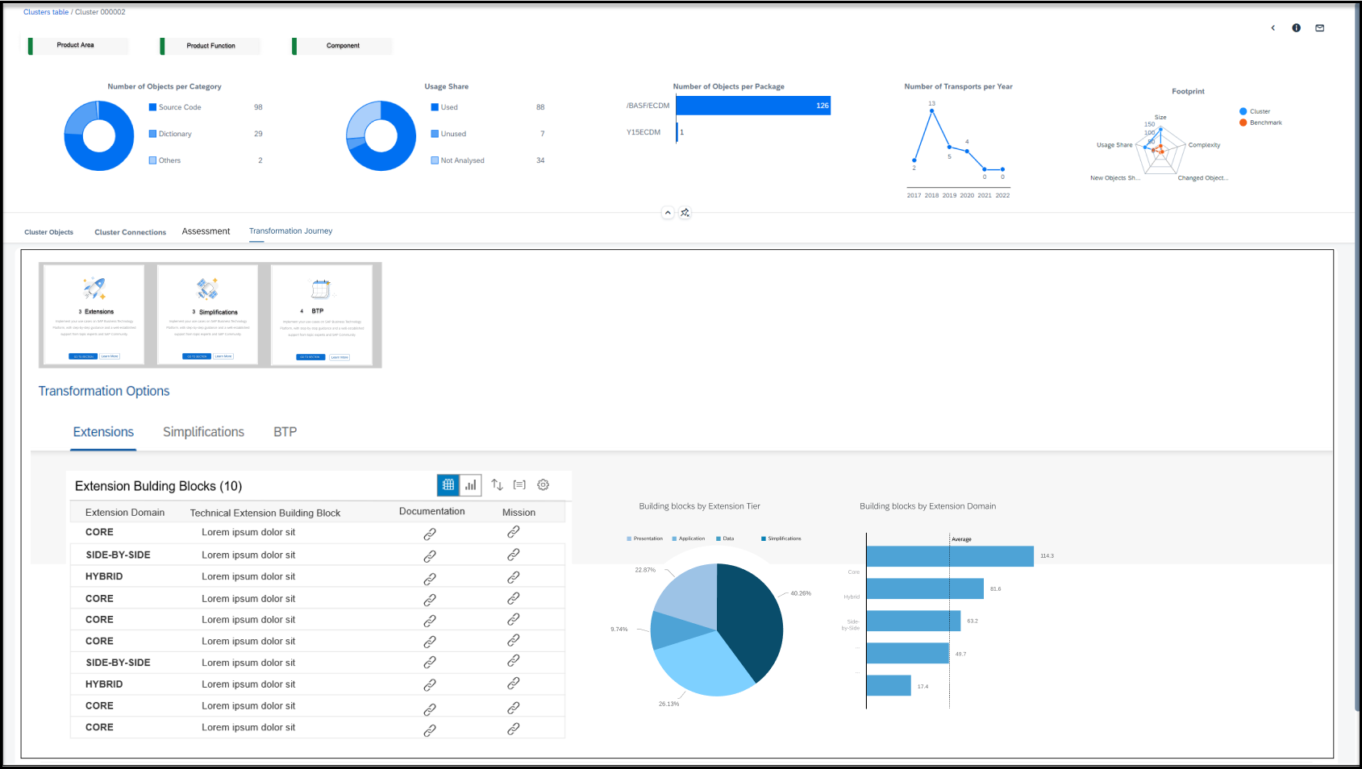
New Tab “Transformation Journey" to see possible Action Items for Cluster
Mockup – Cluster Transformation Journey (3|3) Forms
New Tab “Transformation Journey" to see possible Action Items for Cluster
Each identified Transformation Journey Chapter (Extensions, Simplification, BTP,..) gets an own section to provide
useful Action Items for the cluster. Here Extension section shows Technical Building blocks and allow to link Missions.

Slide 37
Unique custom objects by object type in Cluster 365 ISD

Slide 38
Unique custom objects in Cluster 365 ISD

Slide 39
Forms Insights from Cluster

Slide 40
Forms Insights from Cluster
Rarely used

Slide 41
Forms Insights from Cluster

Slide 42
Forms Insights from Cluster
ZSAPFM06P references 23 custom programs
Next Level reference

Slide 43
Forms Insights from Cluster
Second level reference to custom programs
Table | Custom data
Function | Custom API
Method | Custom API

Slide 44
Forms Insights from Cluster
Table | Custom data
Function | Custom API
Method | Custom API
Custom Tables with Rules ZCUSMMFU

Slide 45
Forms Insights from Cluster
Table | Custom data
Function | Custom API
Method | Custom API
Custom Tables with mapping rule ZCUSMMSI
ZCUSMMTX

Slide 46
Forms Insights from Cluster
Table | Custom data
Function | Custom API
Method | Custom API
Append Structure – Custom Fields

Slide 47
Forms Insights from Cluster
Table | Custom data
Function | Custom API
Method | Custom API
Function Modules

Slide 48
Forms Insights from Cluster
Table | Custom data
Function | Custom API
Method | Custom API
Methods

Slide 49
Forms Insights from Cluster
Table | Custom data
Function | Custom API
Method | Custom API
SM30 table maintenance in cluster 365

Slide 50
ZSAPFM06P_ALL

Slide 51
Forms Configuration and cluster detail
Print program | ZSAPFM06P_ALL | Node: 121150 | Cluster: 365
Form | Z_MEBEST_ALL | Node: 11872 | Cluster: 800000

Slide 52
Reference to custom rules and mapping tables

Slide 53
ZSAPFM06P

Slide 54
Reference to custom rules and mapping tables
ZSAPFM06P does not refer to custom tables – No BRM use case for this
Only Append structure

Slide 55
Text with converging arrow to bullets
Sample bullets
Sample bullets
Sample bullets
Sample bullets
Text
Sample bullets
Sample bullets
Sample bullets
Sample bullets
Text
Sample bullets
Sample bullets
Sample bullets
Sample bullets
Text

Slide 56
Text with converging arrow to bullets
Sample bullets
Sample bullets
Sample bullets
Sample bullets
Text
Sample bullets
Sample bullets
Sample bullets
Sample bullets
Text
Sample bullets
Sample bullets
Sample bullets
Sample bullets
Text

Slide 57
User exits

Slide 58
Identify User exits
CDS View : ZC_BEDGES
Search:
Function Modules for code:
'FUNC' in TO_OBJTYPE
EXIT_* in TO_OBJECTNAME
Option: 2
Customer projects: MODACT
SAP Components : MODSAP ( E - Function Exit, S - Screen Exit, T - Table, C - GUI Code)
Combine these two tables to get the Customer implemented SAP components in projects
Custom tables that have incoming references from these Function exits?

Slide 59
CMOD

